Slide 1




Slide 2




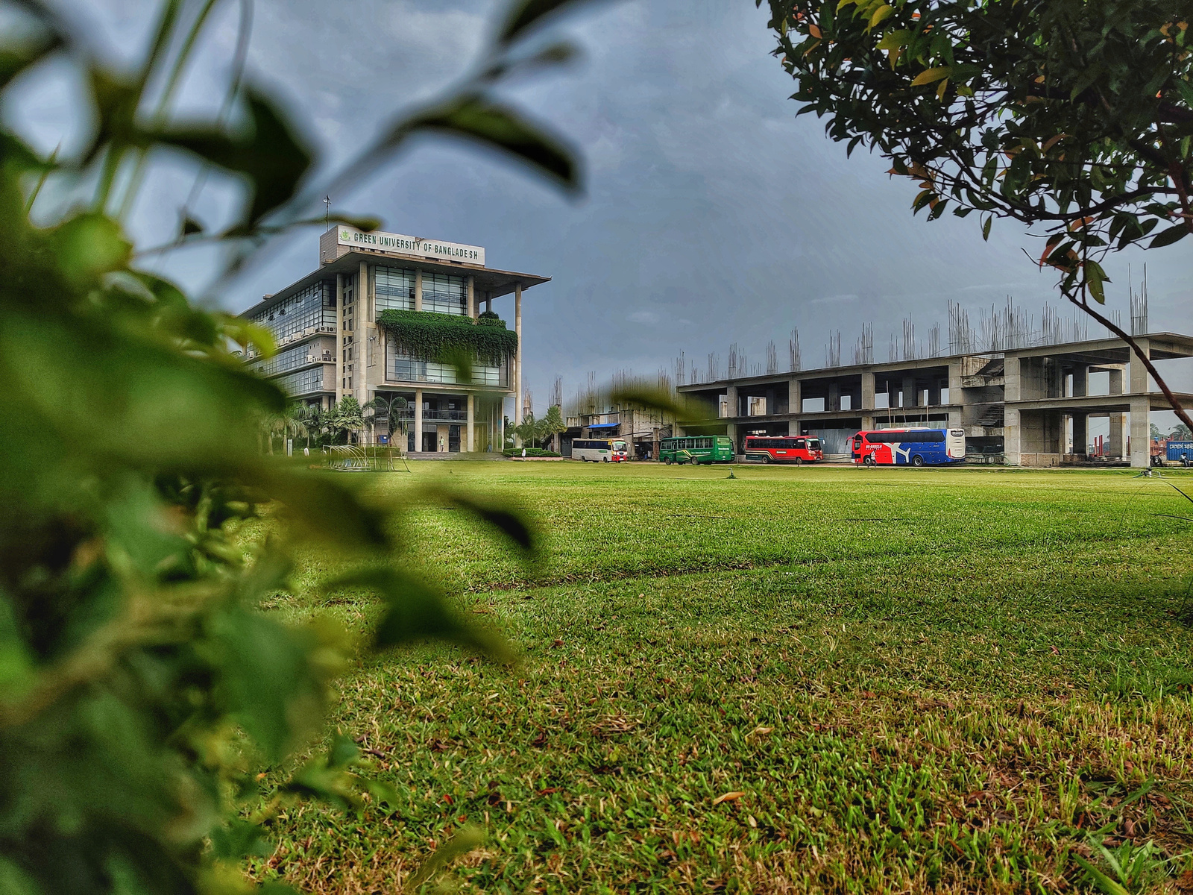

Green University of Bangladesh
Department Of Computer Science and Engineering(CSE)
Course Title: Data Communication
Course Code: CSE 307 Section: 221_D7
Presented to:
Md. Abu Rumman Refat
Lecturer, Dept. of CSE
Green University Of Bangladesh

Slide 3






Coaxial Cable
Welcome To Our Presentation

Slide 4



Md. Mahim Hossain
221902082

Slide 5




Agenda
Introduction
What is Coaxial Cable?
Layers
Transmission Characteristics
Advantage & Disadvantage
Categories of coaxial cables
Applications
Conclusion

Slide 6


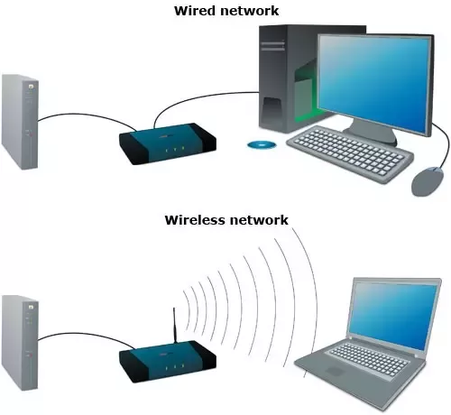
Introduction

Slide 7



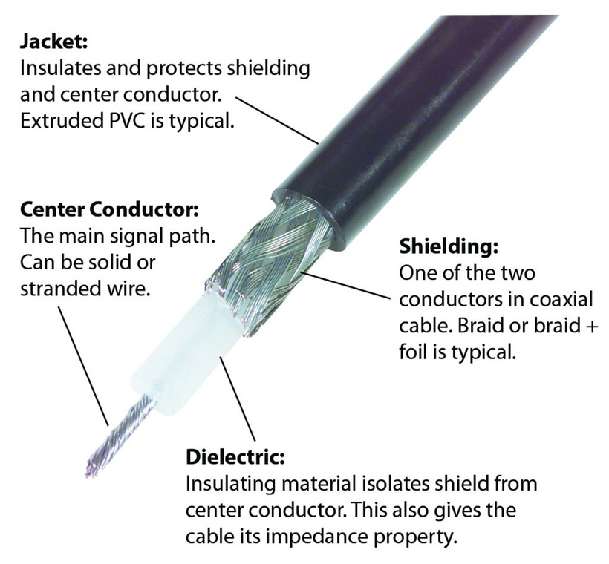
What is Coaxial Cable?

Slide 8


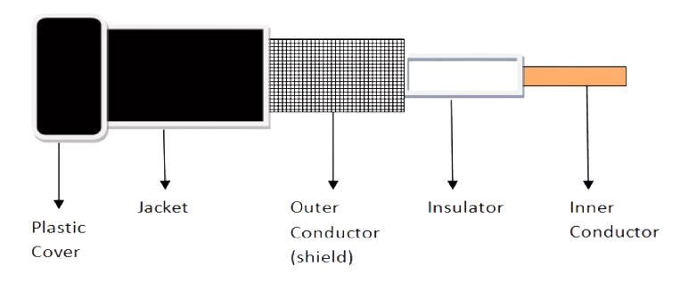

layers
Outer conductor is braided shield
Inner conductor is solid metal
Separated by insulating material
Covered by padding

Slide 9

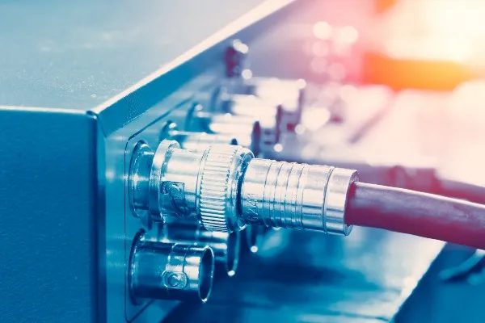

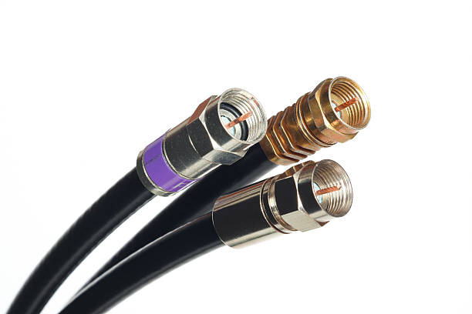
Transmission Characteristics
Analog signal
Amplifiers every few km
Closer if higher frequency
Up to 500MHz (about 4MHz for each TV channel)
Digital signal
Repeater every 1km or so
Closer to higher data rates

Slide 10


Md. Zahidul Islam
221902091

Slide 11

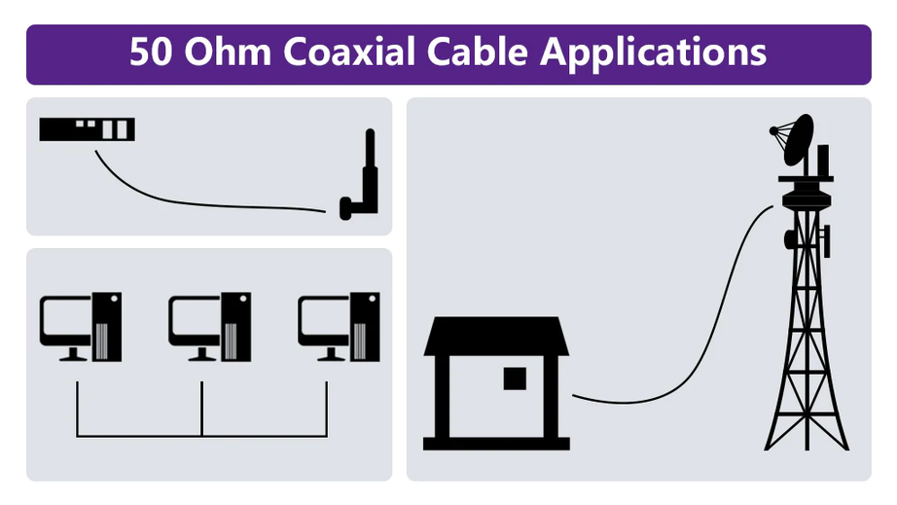

Applications
Television distribution
Cable TV
Long-distance telephone transmission
Can carry 10,000 voice calls together
Being replaced by fiber optic
Local area networks

Slide 12

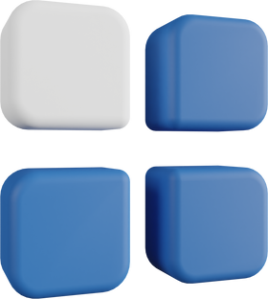
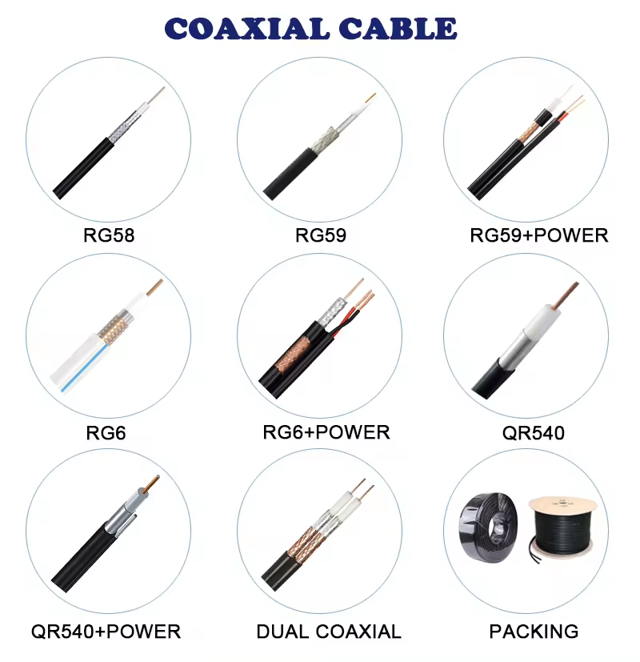
Categories of
Coaxial Cables
Category | Impedance | Use
RG-59 | 75 Ω | Cable TV
RG-58 | 50 Ω | Thin Ethernet
RG-11 | 50 Ω | Thick Ethernet

Slide 13

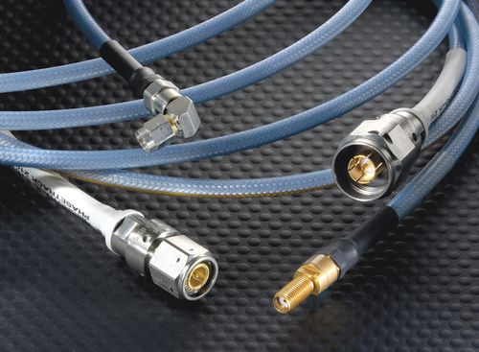

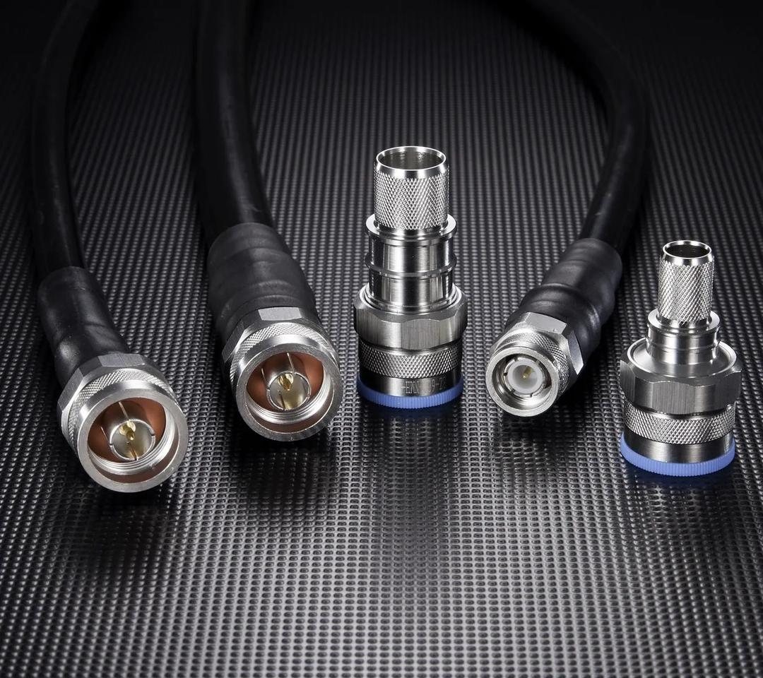

Advantage & Disadvantage
Advantage
Disadvantage
Higher noise immunity
High attenuation
High Transmission rate
Comparatively costly
Great channel capacity
Difficult to install

Slide 14



Conclusion
Reliability
Efficiency
Versatility

Slide 15



Thanks for Watching
Thanks everyone for being here – your presence means a lot!
Any Question, Just Ask don't be shy
Grateful for your presence! Thank you all!
The Team :
March 28, 2024

